Slide 1
Content case study:
ANZ GoBiz
Jake Kraweckyj

Slide 2
The context
Almost every Australian person or business has some involvement with ANZ.
ANZ previously focused on personal finance and large-scale business finance, and wanted to branch out to small and medium-sized businesses.
Start-ups like Prospa and Nimble had 33% of the SME market in 2019, compared to just 10% the year before.

Slide 3
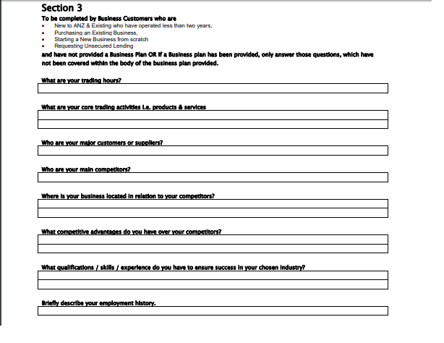
What ANZ offered customers in 2019…

Slide 4
What ANZ offered customers in 2019…
ANZ’s process involved a paper form that a customer would need to fill out, sign, scan, then send to the National Business Centre in Melbourne.
SMEs would receive a call from an ANZ banker or be invited to discuss their application in person.
Within 30 days (!) they’d receive a response on whether their application for a loan, overdraft or other lending product was successful.

Slide 5
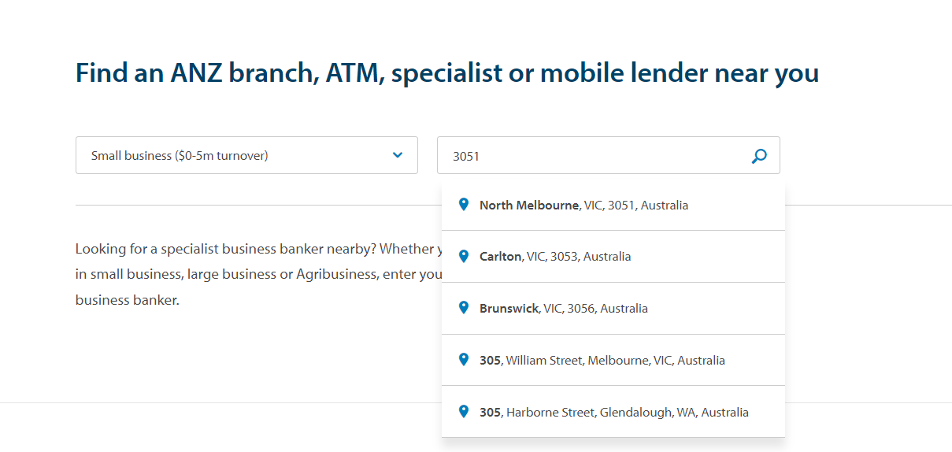
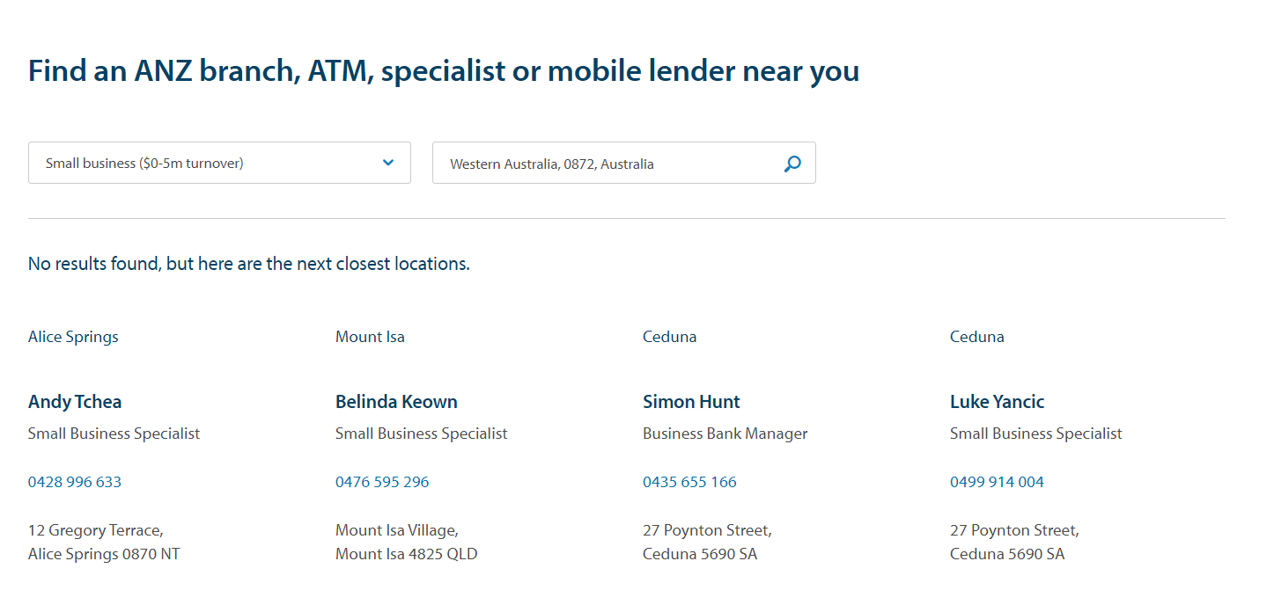

Slide 6
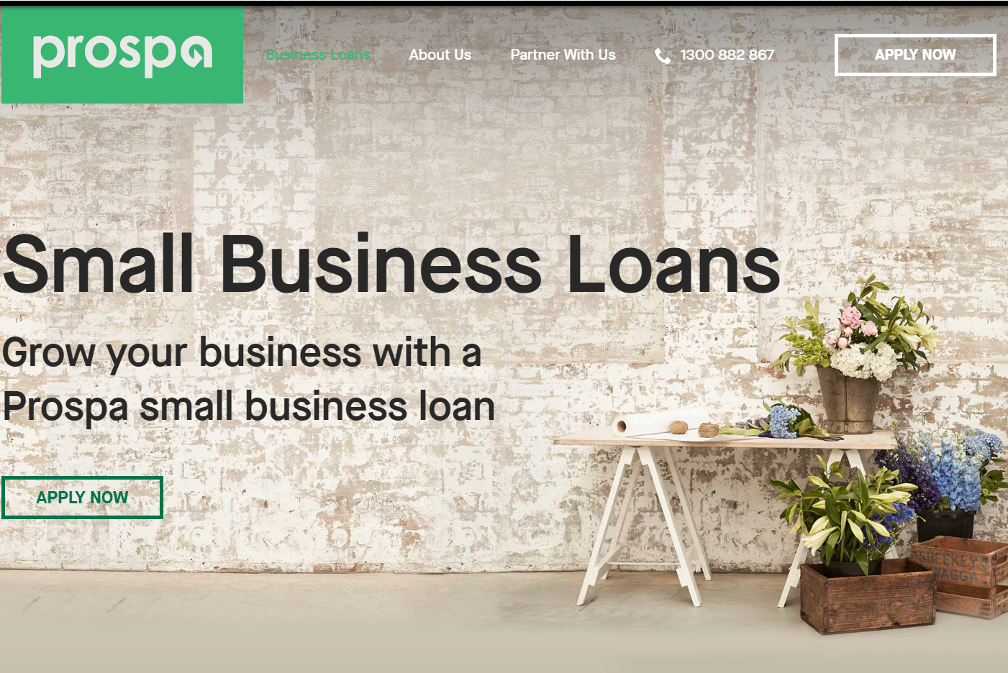
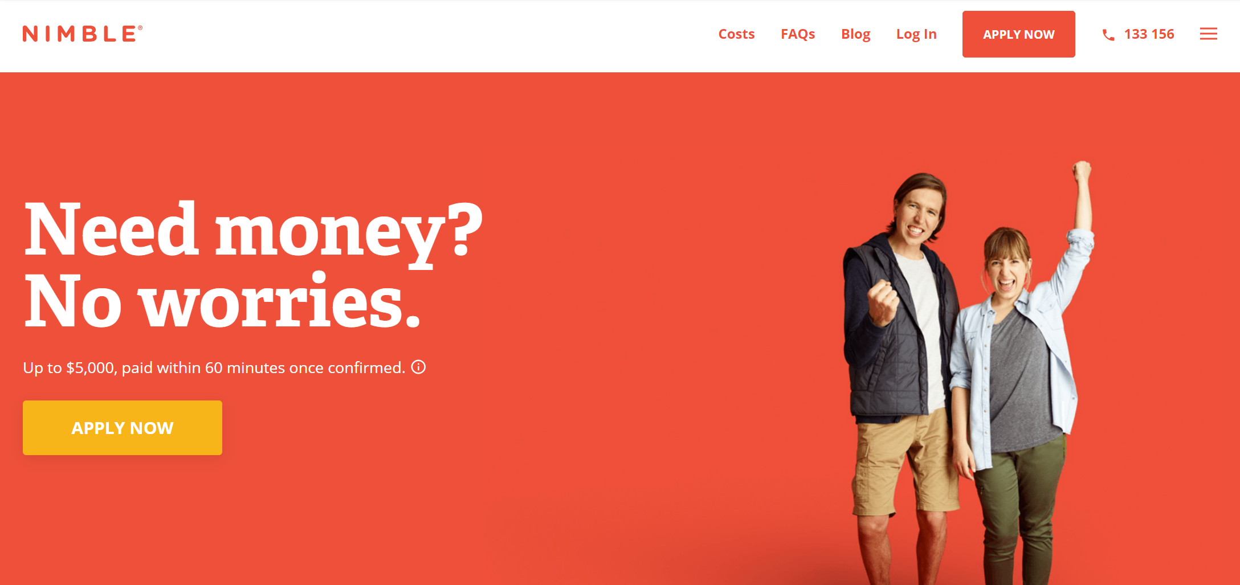
The COMPETITION in 2019

Slide 7
Our customers’ pain points
When talking to real SMEs about their needs from a lender:
- They didn’t have weeks to wait for a loan, they needed it in hours (or days at a push).
They’d turn to newer, more agile companies even though they weren’t as well known.
They were prepared to pay back double the interest rate, in half the repayment time, if they were guaranteed that speed of delivery.
They appreciated ANZ’s expertise and insight, but needed an answer at pace.

Slide 8
What ANZ aimed to offer post-2020
A quick, easy-to-use online application.
A snapshot of real-time financials from MYOB, Quickbooks and Xero to calculate loan amounts in minutes.
A way to send unconditional offers in just hours, not days or weeks (subject to financial checks).
Something industry-leading, not just a digitised version of the existing application form.
That same expertise and level of trust they’d expect from a ‘big four’ bank, but with the speed and flexibility of a start-up.

Slide 9
User story
AS A small business owner
I WANT to apply for the right lending, fast
SO THAT I can keep my business running smoothly

Slide 10
This is where I came in…
Design team and researchers had done initial user interviews with SMEs.
I was brought in just after the stage where ANZ had decided which back-end approach they’d use to create the application, but with no concrete wireframes. Just one or two rough ideas.
Brought in to help create a clickable prototype proof-of-concept.
Slowly got more and more involved with back-end devs, Legal, Compliance, Risk, Product, other areas of Design and more.

Slide 11
The questions we needed to ask ourselves
We have the technology and the budget to speed up this application process in the back-end. What does an industry-leading online application look like from the front-end?
There are lots of steps for an SME to complete, and a lot of information we need from them even before the conditional offer. How do we make this feel as natural as possible?
How can we keep SMEs informed every step of the way, and manage expectations if they don’t get the amount they asked for?
How can we replicate that level of trust and expertise from an ANZ banker, in an (almost) purely online application?

Slide 12
EXAMPLEs OF job stories
WHEN I start the application process
I WANT to know how long the application will take
SO THAT I can book out the right amount of time to complete it
WHEN I start the application process
I WANT to know when to expect an answer
SO THAT I can make other plans if I’m unsuccessful

Slide 13
EXAMPLEs OF job stories
WHEN I confirm my details
I WANT to double-check what I entered
SO THAT I reduce the chance of error before sending
WHEN I complete the application
I WANT to understand which is the right lending for me
SO THAT I can borrow what I need, and know what I can pay back

Slide 14
The approach we took
A team of 4 – me, UX designer, researcher, project stream lead.
Worked closely with Legal, Risk, Product and Compliance too.
Originally thought about creating a chatbot to guide users through.
Chatbots replicating in-person services, then referring them to real bankers, confused people and felt ‘uncanny’.
Created a series of natural language forms, that would contain multiple questions in one or two sentences.
Context-led, and able to generate new questions depending on what people previously entered. Created a ‘user voice’ for customers to enter this information.
Then, would add in ‘banker voice’ sections which would feed back on the progress made so far.

Slide 15
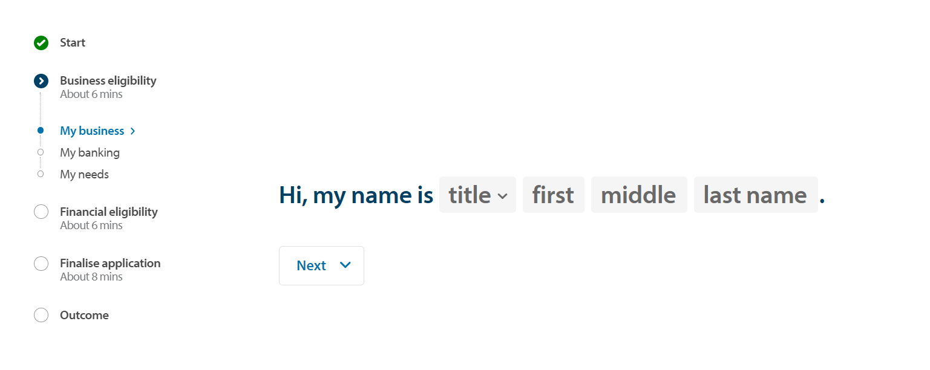
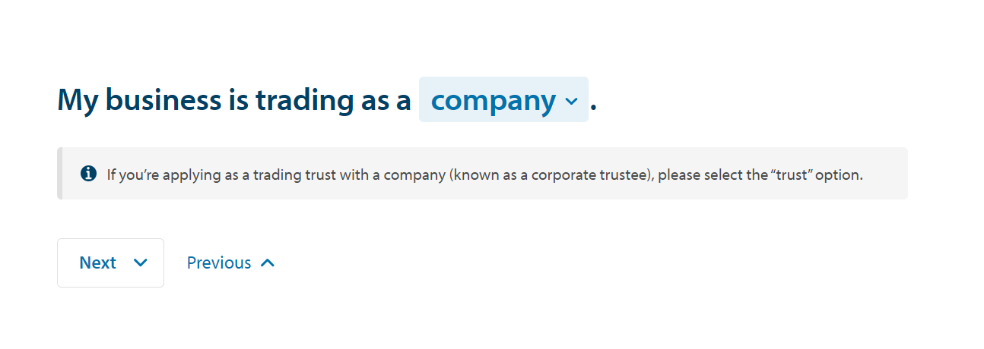
Examples of user voice

Slide 16
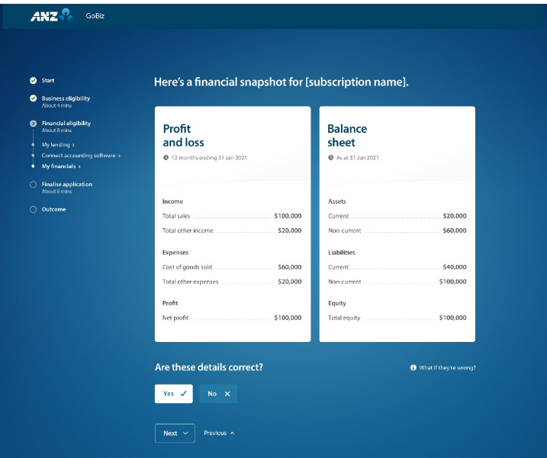
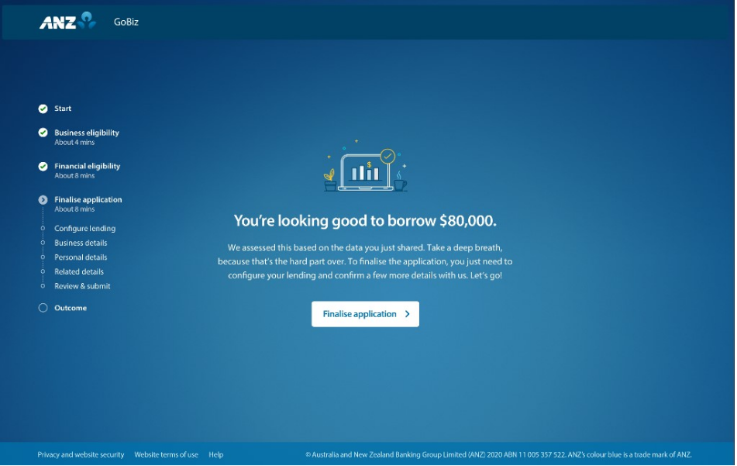
Examples of banker voice

Slide 17
Connecting the back and front-ends
Worked with devs and Product experts to expand on the wireframe and bring features to life.
Example:
There were 3 different lending types to choose from, but we needed to confirm the reason why someone needed lending before suggesting the right option for them.
Originally we created a bank of 70+ keywords which someone could choose from, which would reveal 9 or 10 sub-options (e.g. unsecured loan for 1/2/3 years, unsecured overdraft for 1/2/3 years, asset hire for 1/2/3 years).
From there we could direct users to the right product for them, with the right timeframe (e.g. light business renovations = unsecured loan for 1 year, business re-building = unsecured overdraft for 3 years).

Slide 18
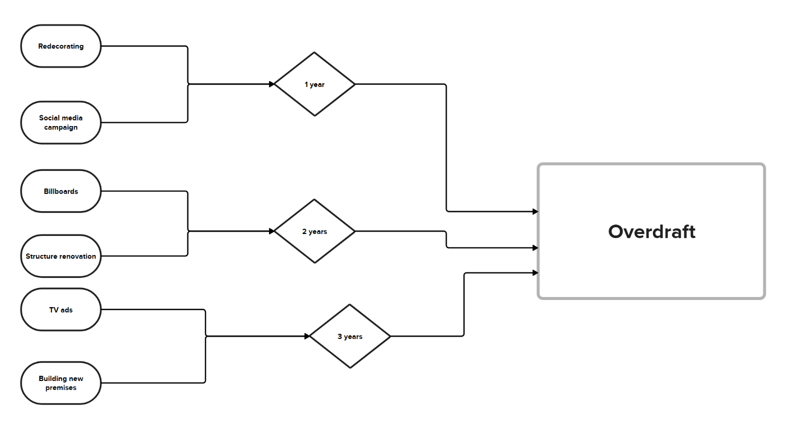
Connecting front and back end (part 2)

Slide 19
The approach we took (part 2)
Tested various iterations of designs with real SMEs.
Incorporated qualitative testing, including the highlighter test.
‘I like how simple the questions are to answer’.
‘It doesn’t feel like I’m filling out an application form at all’.
‘It feels like ANZ knows me’.
‘I like the reassurance at the end of each section.’

Slide 20
The problems we encountered…
Legal and Compliance insisting that we use more ‘corporate’ language for an SME audience.
We brought key stakeholders from those teams into testing so they could see for themselves how SMEs struggled with that language.
Before: ‘In the past 12 months I diversified my business portfolio’.
After: ‘In the past 12 months I entered a market that I didn’t operate in before’.
As of 2023, the wording has changed in line with whether someone’s primary business function has or hasn’t changed (allowing for more flexibility in the answer).

Slide 21
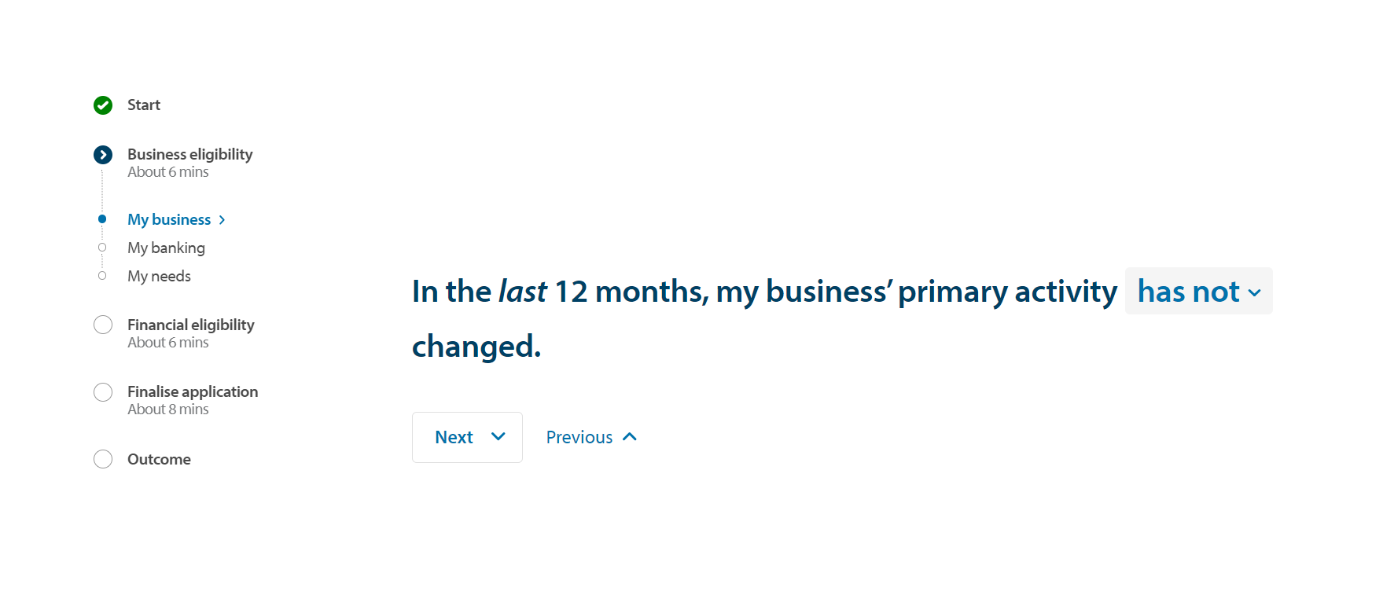
example of simplified language (as of 2023)

Slide 22
The problems we encountered… part 2
SMEs were initially unsure that the automated process could calculate their lending amount so quickly.
‘Has it had time to think?’
Had to add in an artificial 15-second transition screen to tell them that it was ‘calculating’ their lending arrangement, even though it had already happened.

Slide 23
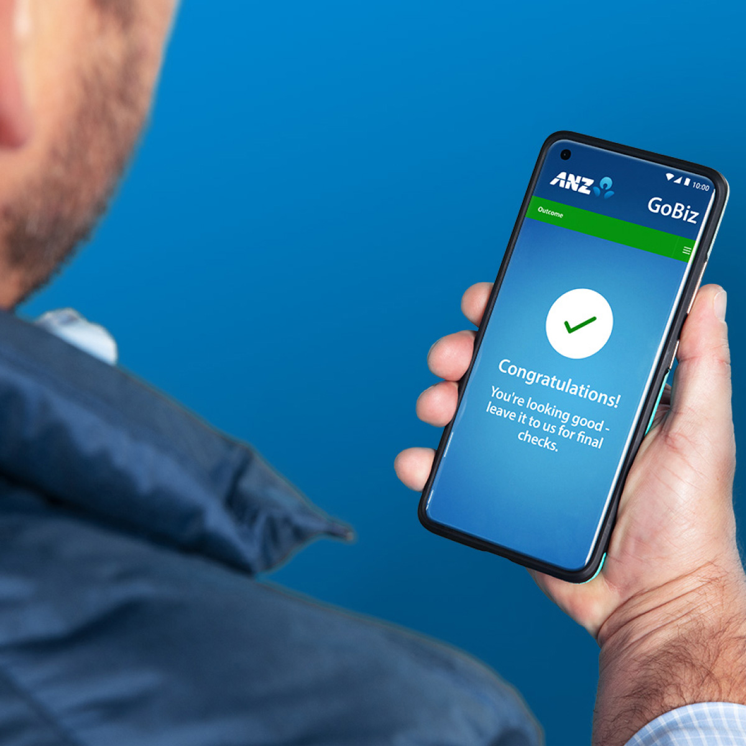
example of transitional screen (as of 2023)

Slide 24
The results of the process (2020)
Reduced waiting time for an unconditional offer to just 48 hours, down from 30 days.
SMEs could complete their application within 25 minutes, having answered all of the questions ANZ needed.
If SMEs were better suited to other products, we could share that information in the middle of the journey rather than informing them weeks after.

Slide 25
The results of the process (2020-2024)
Adapted for a post-COVID world (i.e. questions were changed to reflect COVID-related downturn in the last 12 months).
Nearly 3,000 applications per month (almost 100 per day) or roughly 14% of the market share.
Internal NPS score: 67 (3 points away from ‘world-class’).

Slide 26
Any questions?

