Slide 1
Content case study: William hill
Jake Kraweckyj

Slide 2
The context
William Hill is one of the world’s largest betting / gaming providers, and has a considerable size of the UK market.
Each year, 500+ suicides in the UK are linked to gambling related harm.
As a business who profits from gamblers placing bets and playing on our games, how can we make sure that people do this safely and sustainably?
Is prevention better than cure, and do people know how much they spend on a daily, weekly or monthly basis?

Slide 3
The gambling landscape in the uk
William Hill works closely with the Gambling Commission, and stays multiple step ahead of UK legislation being passed into law.
Recent data suggests that the gambling industry as a whole wasn’t doing enough to protect customers before their gambling became an issue.
Problem gamblers make up between 3-5% of the gambling population, and is sometimes linked to other factors like mental health issues and substance abuse.

Slide 4
Our users’ pain points
We asked users about the kinds of protections they would consider when placing multiple bets a day or week.
70% of the participants said that something like a deposit limit tracker would be useful to reduce problem gambling.
Only 20% said that they would ever use it.
‘I’m already in control of my finances’.
‘I wouldn’t want to stop myself from an opportunity to win more money’.

Slide 5
What This meant for William hill
It was clear that people would find some kind of tracker useful.
A tracker would only be truly useful if people needed to use it, for a set time, or have the option to add it at any time before any further intervention is needed (e.g. gaming breaks, timeouts, exclusions, bank account blocks).
Is it a change in behaviour that’s needed, or a change in mindset in general?

Slide 6
User story
AS A person who gambles online
I WANT to understand how much I’m spending
SO THAT I can make a decision on what I’ll bet in future.

Slide 7
This is where I came in…
Design team and researchers had done initial user interviews with SMEs.
I worked closely with design and research to provide a proof of concept for a deposit limit tracker.
This would help users to map out how much they spent on a daily, weekly or monthly basis.
Slowly got more and more involved with the Gambling Commision, Legal, Compliance, Risk, Product, and more.

Slide 8
EXAMPLEs OF job stories
WHEN I place a bet
I WANT to see how much I’ve spent that day, week or month
SO THAT I can assess how much I should spend next (if anything).
WHEN I reach my deposit limit
I WANT to know what that limit is
SO THAT I can decrease the limit (automatically) or increase it (in writing).

Slide 9
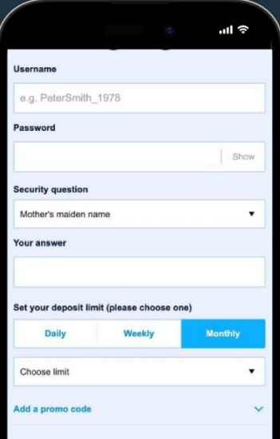
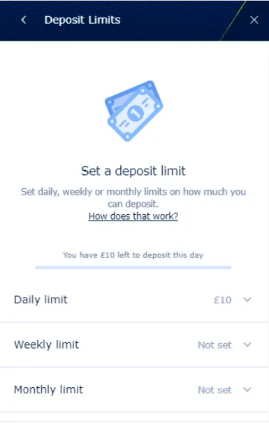
Deposit limit setting

Slide 10
The problems we encountered…
Needed to confirm with Policy and Risk that we could add a deposit limit as standard for all customers, to get them accustomed to the idea
Tracker was calculated day-to-day, week-to-week etc. so if I had a £50 monthly deposit limit and deposited £40 on the 7th May, then £10 on the 14th, then my deposit limit would reset on the 7th May rather than the 1st June. How could we explain that to users without ‘giving away’ too much of our calculation formulae?
Some Risk stakeholders and Product stakeholders had regular disagreements – Risk wanted this deposit limit tracker to limit over-depositers on placing a bet, whereas Product focused on the idea of ‘users still choosing to place a bet’ and making this advisory only.

Slide 11
The results of the process
Deposit limit tracker was, unfortunately, descoped due to stakeholder disagreements.
It raised the question internally of what our customers need from us – the opportunity to place a bet with full knowledge of their spending, or the requirement to stop placing bets while knowing exactly why they’ve been blocked from doing it.
The aim now is to address the disparity between the two, and come to an agreement where users are fully informed about the amount they’re spending.

